Slide 1
A Data Visualization study of Scarlet Fever in the US states of New York, Ohio and Pennsylvania
Subject : Data Visualization Course: Master’s In Applied Computer Science
Name: Venkat Vadlamudi Matriculation number :12100521 Mail id: venkat.vadlamudi@stud.th-deg.de
Name: Yogesh Nagor Matriculation number :00815160 Mail id: yogesh.nagor@stud.th-deg.de
Date of Submission : 1/07/2023

Slide 2
INTRODUCTION
Scarlatina, or scarlet fever, is an infectious condition brought on by the Group A streptococcus (GAS) Streptococcus pyogenes. The illness is a specific sort of Group A streptococcal infection. Between the ages of five and fifteen, children are most frequently affected. A sore throat, fever, headache, swollen lymph nodes, and a distinctive rash are some of the warning signs and symptoms. The rash is red and blanching, and the face is flushed. The tongue may be red and rough, and it typically feels like sandpaper. The exotoxins produced by S. pyogenes cause capillary injury, which leads to the rash. It could be difficult to see the rash on skin with darker pigmentation.
Few persons with strep throat or streptococcal skin infections go on to develop scarlet fever. People typically spread the bacterium by sneezing or coughing. Additionally, it can be transmitted when a person touches something with the bacteria on it before touching their mouth or nose. Swabs of the throat are often cultured to confirm the diagnosis. Scarlet fever is not prevented by a vaccination. Prevention measures include routine hand washing, not sharing personal belongings, and avoiding contact with others when ill. Antibiotics can be used to treat the illness since they stop the spread of the illness’ symptoms and the majority of its problems. If treated, scarlet fever usually has positive outcomes. Scarlet fever can cause long-term consequences such kidney failure, rheumatic fever, and arthritis.

Slide 3
Symptoms of Scarlet Fever
Before the rash develops, scarlet fever can cause a variety of symptoms in your child including: Fever
Sore Throat
Headache
Chills
Vomiting
Stomach Ache
Coated White Tounge
The rash begins about one to two days after the initial infection. The red, fine, “sandpaper-like” rash is usually found on the neck, forehead, cheeks, and chest, and then may spread to the arms and back. The rash usually begins to fade after three to four days.

Slide 4
Objective And Methods used
Objective : To understand the epidemiological pattern in the number of infections of Scarlet fever reported in the US states of New York, Ohio and Pennsylvania. Moreover, to identify the similarities and dissimilarities in the trend. The various States of The United States of Americas is also tried to be ranked according to various factors such as Number of total infections, total number of deaths and its associated Case Fatality Rate.
Method used : The data provided includes information for all fifty US States. The top three states in terms of population density are New York, Ohio and Pennsylvania, and these three are picked as States of Interest. Furthermore, it is obvious that these states have a substantial number of infections. The accessible recordings from the 1888–1966 era were included, after which they underwent analysis. Project Tycho is where the data for the input is gathered. Particular emphasis is placed on the number of illnesses and the corresponding number of fatalities.
With the aid of the above method, the Case Fatality Rate, which represents the percentage of infections to deaths for each State, can also be calculated. This will get the Case Fatality Rate per when multiplied by 100.

Slide 5
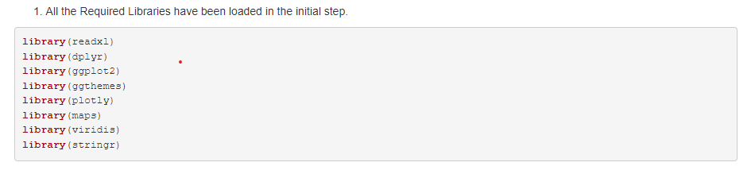
Libraries used
These libraries were used in the project to handle data import, perform data manipulation and transformation, create static and interactive visualizations, customize plot aesthetics, work with map data, and manipulate strings.

Slide 6
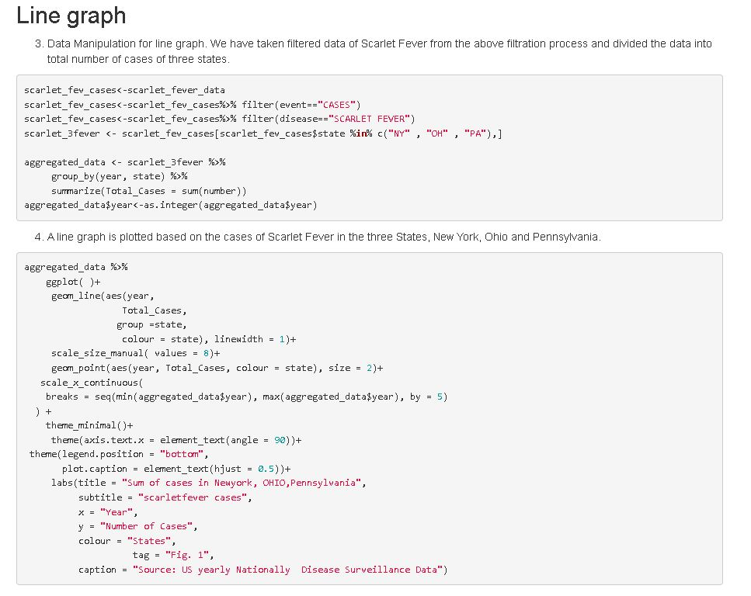
Line graph : Manipulation of data for a line graph. We have split the data on scarlet fever into the total number of cases in the three states using the filtered data obtained from the aforementioned filtration technique.

Slide 7
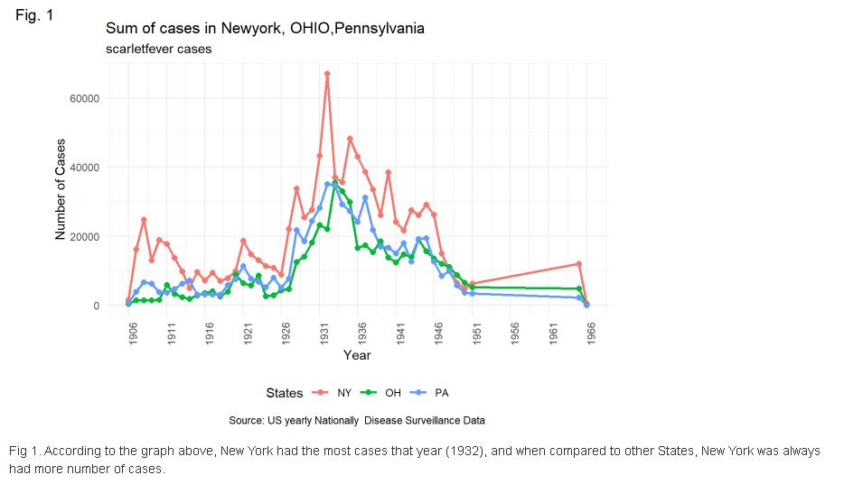
1. Data Manipulation for line graph. We have taken filtered data of Scarlet Fever from the above filtration process and divided the data into total number of cases of three states.

Slide 8
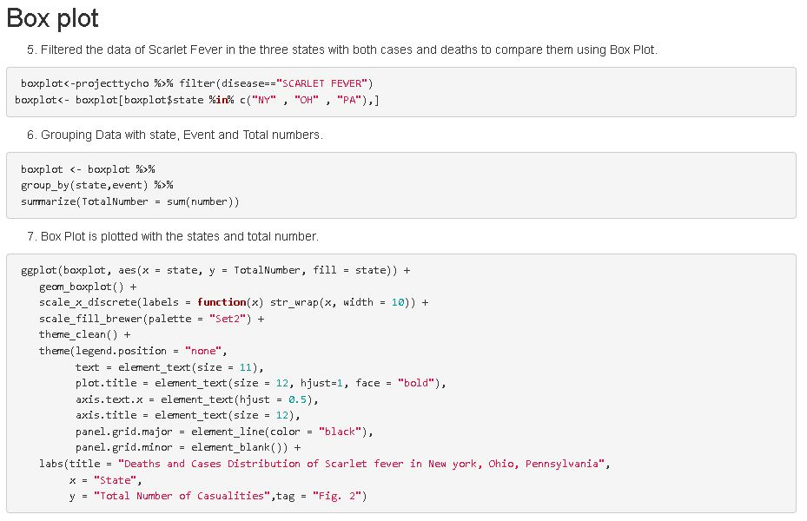
Box Plot : Using a box plot, the data on cases and fatalities from scarlet fever in the three states was filtered.

Slide 9
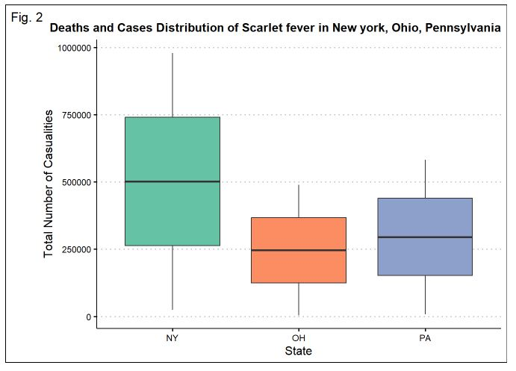
2. Filtered the data of Scarlet Fever in the three states with both cases and deaths to compare them using Box Plot.

Slide 10
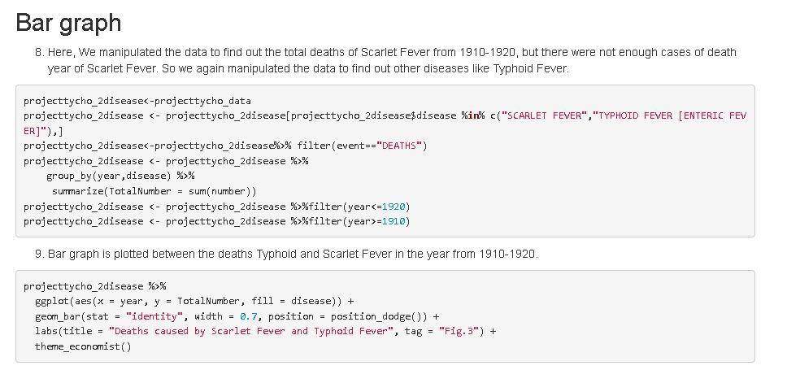
Bar graph : Since there weren't enough cases of scarlet fever fatalities in any given year, we had to alter the data in order to determine the overall number of scarlet fever deaths from 1910 to 1920. Therefore, we altered the data once more to discover new illnesses like typhoid fever.

Slide 11
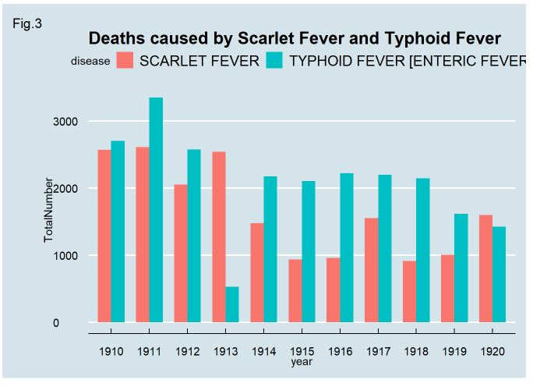
4. We manipulated the data to find out the total deaths of Scarlet Fever from 1910-1920, but there were not enough cases of death year of Scarlet Fever. So, we again manipulated the data to find out other diseases like Typhoid Fever.

Slide 12
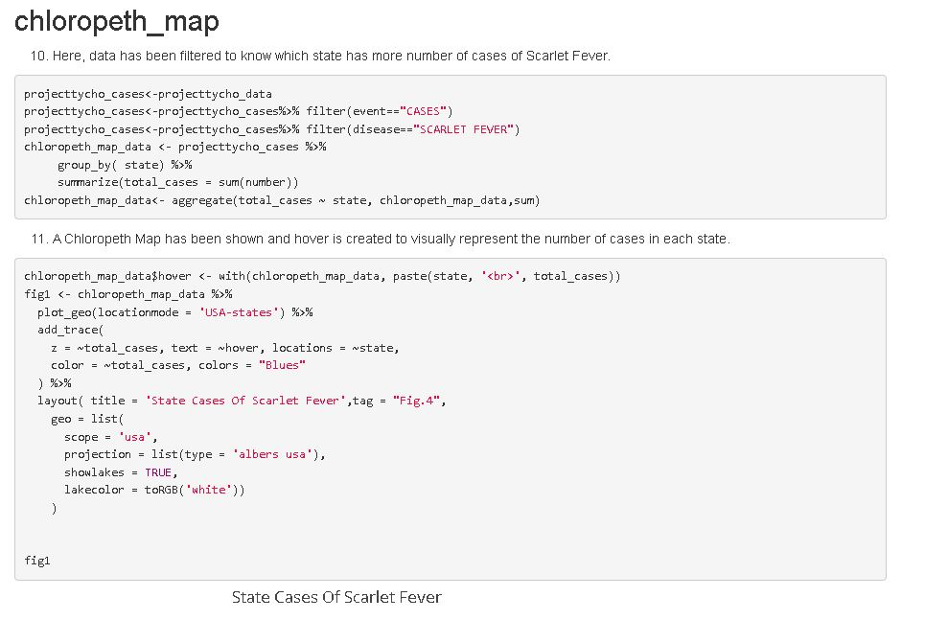
Choropleth Map : Data has been filtered in this case to determine which state has the greatest number of Scarlet Fever cases.

Slide 13
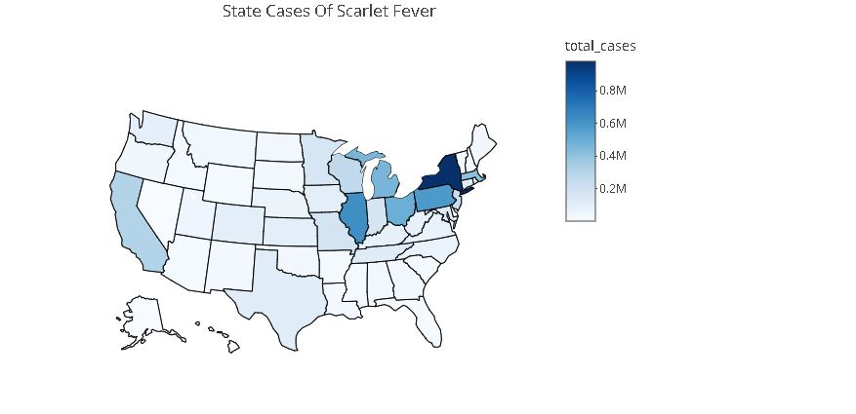
4. Data has been filtered to know which state has more number of cases of Scarlet Fever.

Slide 14
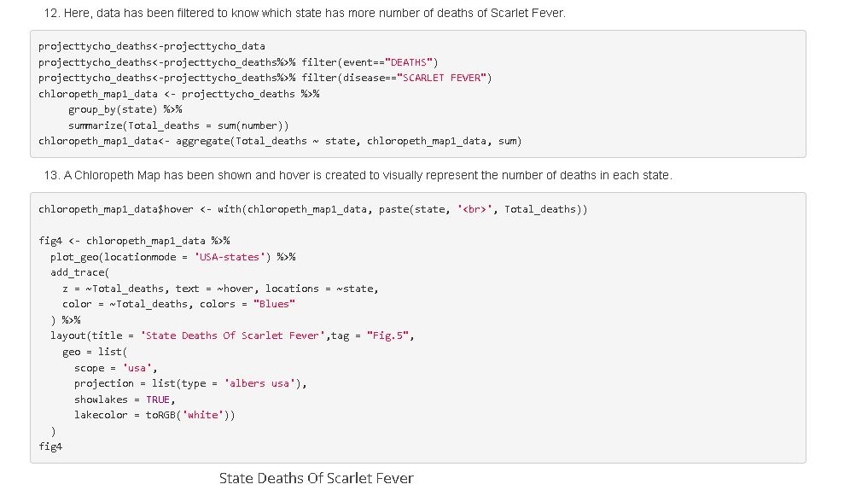
Choropleth Map : Data has been filtered in this case to determine which state has the greatest number of Scarlet Fever Deaths.

Slide 15
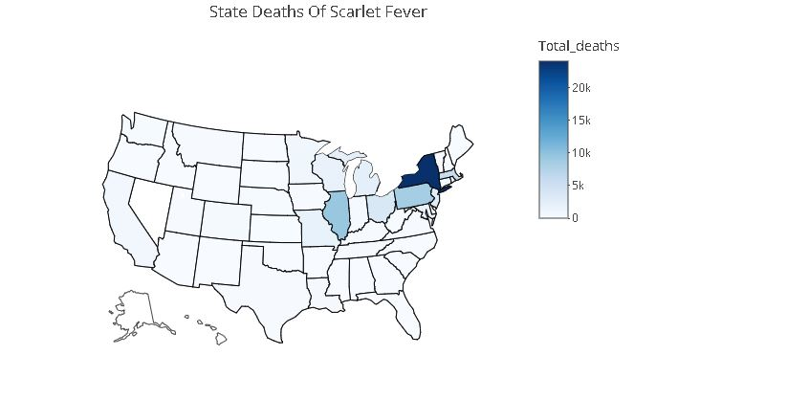
5. Data has been filtered to know which state has more number of deaths of Scarlet Fever.

Slide 16
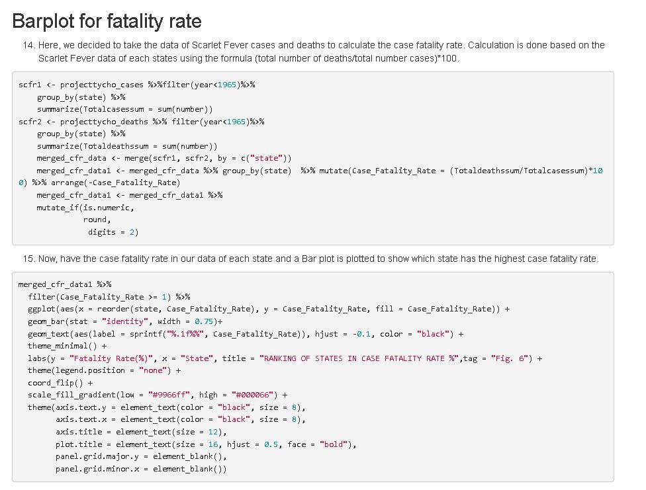
Bar Plot : In order to determine the case fatality rate, we chose to use data on Scarlet Fever cases and fatalities. The calculation is made using the formula (total number of deaths/total number of cases)*100 based on the Scarlet Fever statistics of each state.

Slide 17
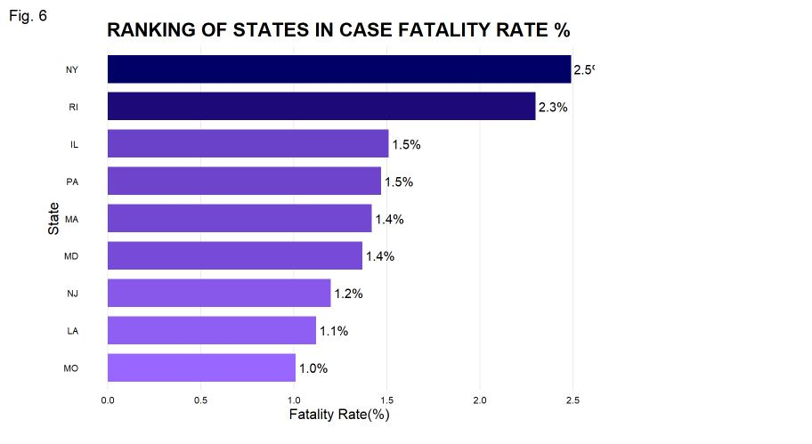
6. We have the case fatality rate in our data of each state and a Bar plot is plotted to show which state has the highest case fatality rate.

Slide 18
Discussion and Conclusions
Discussion : Since the data was made accessible over a brief period, it was incredibly large and included all of the variables. It was easy to analyze correctly and visualize many stages of the Scarlet Fever in the United States. Data from three states—New York, Ohio, and Pennsylvania—have been analyzed. To know more information about scarlet fever, the case fertility rates of each state in the USA has been analyzed.
During the analysis stage we faced an issue while comparing the years of deaths and cases of scarlet fever, the death years were less compared to the infected years. So, we compared with other diseases which were having deaths during duration of scarlet fever. Disease like typhoid fever occurred during the time of scarlet fever and we discussed to plot graphs between the deaths of scarlet fever and typhoid fever.
Conclusion : The submitted data is subjected to a number of changes before being given a full analysis. For a flawless analysis, every attribute that is available is used to its fullest extent. Several plots, ranging from maps to standard graphs, are produced as a result of this investigation.

Slide 19
THE END

